Slide 1


Friends of the Mount Vernon Library
Annual Membership Levels:
[ ] $5 Browser [ ] $10 Page Turner [ ] $20 Short Story [ ] $50 Novel
[ ] $100 Bestseller [ ] $250 Classic [ ] $500 Publisher
[ ] $ Other
Name:
_______________________________
Address:
_____________________________
_____________________________
City: _________________________
State: ________ ZIP: ___________
Email:
_______________________________
Phone: _________________________
 Check this box if you’d like to be notified via email of special Friends-related events.
Please make checks payable to:
Friends of the Mount Vernon Library.
The Friends is a registered 501 (c)(3) nonprofit entity.
I would like to help with:
Book Nook
Special Events
As Needed
Friends of the Mount Vernon Library
315 Snoqualmie Street
Mount Vernon, WA 98273
Join the Friends of the
Mount Vernon Library Today
Friends are advocates for literacy and reading, and promote the library as a vital informational, cultural, and educational asset to our community.
frndmvlib@gmail.com
http://www.mountvernonwa.gov/Library
360-336-6209

Slide 2
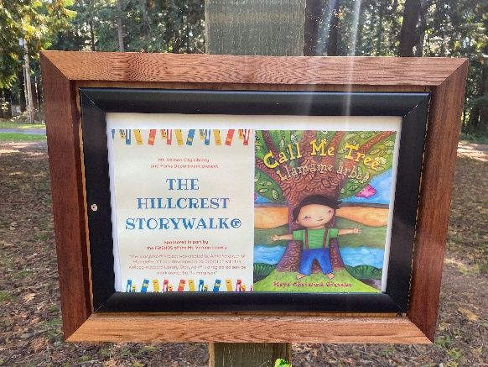
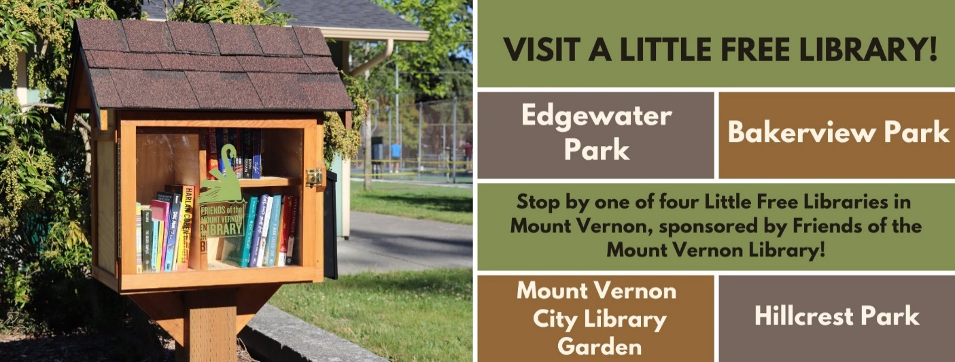
The Friends of the Mount Vernon City Library help the Library provide services and events it wouldn’t be able to offer without their support.
Recent
Accomplishments
The Friends provide supplemental funding to the library and have been actively continuing this support throughout COVID-19. They have funded several new projects over the last couple years such as the Hillcrest Park Storywalk, the construction of 4 Little Free libraries, and Wee Readers bilingual preschool book kits. Proceeds from membership dues, donations and fundraisers help pay for special library programs and services not funded by the regular library budget.
You can thank the Friends for:
Children’s Programming
Summer Reading Program
Book Nook
Improved Wi-Fi Connection
Little Free Libraries at MV Parks
Hillcrest Park Storywalk
Adult Programming
Juvenile Detention Book Fund
Wee Readers Book Kits
Shelving and Displays
Seating and Study Areas
Reference Room Art Gallery
PURPOSE
The Friends of the Mount Vernon Library
Enhance the functions, resources, and services of the Library;
Heighten public awareness of the Library; and
Encourage gifts and bequests to the Library from corporations, businesses, community organizations, and private citizens.
About the Friends
The Friends is a 501(c)3 organization dedicated to supporting the library by providing funding, direct service or in-kind support of library projects and events and advocating for the library.
Members of the Friends lend their support through membership dues, donations of money or materials, and volunteerism.
To find out more about the Friends, feel free to attend a business meeting. These are held the third Wednesday of each month at 6:00pm at the library.
You can also find the Friends on the Library’s website under “About” at: www.mountvernonwa.gov/Library

